Slide 1
NoSQL Implementation
DSA II Project
Project Members :
142203002 – Sohel Bargir
142203004 – Pratyay Dhond
142203012 – Sarvesh Kulkarni
Under the guidance of
Prof. Ashwini Matange

Slide 2
Objectives
To implement the NoSQL database ideology with multi-user support using C programming language and DSA Concepts.
To provide following functionalities to user :
  Create Database
  Performing CRUD operations on data
  JSON support
Encrypted data storage

Slide 3
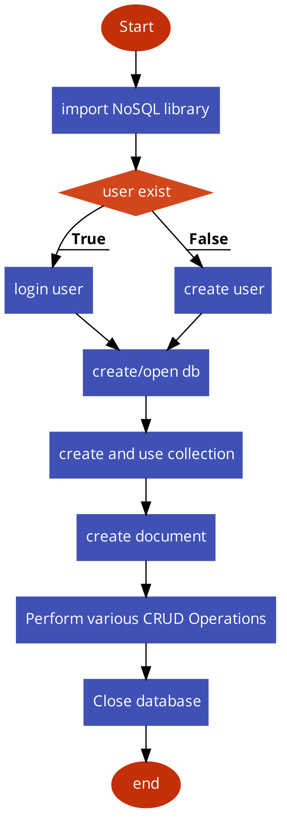
Block diagram

Slide 4
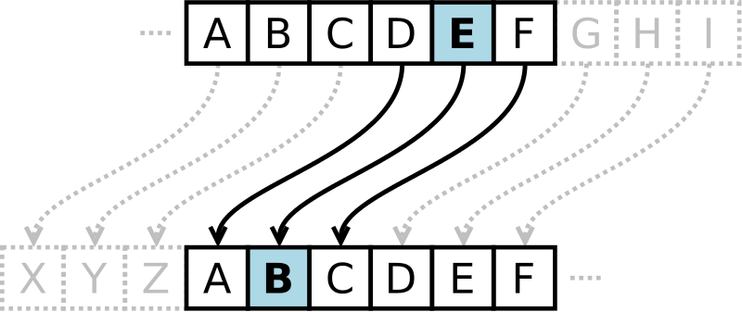
Algorithms Used :
Caesar Cipher (Modified)
Poly-Alphabetic Cipher

Slide 5
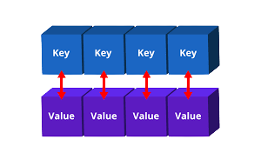
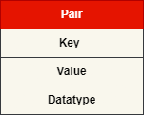
Data Structures Used :
Hashmap
Pair
LinkedList

Slide 6
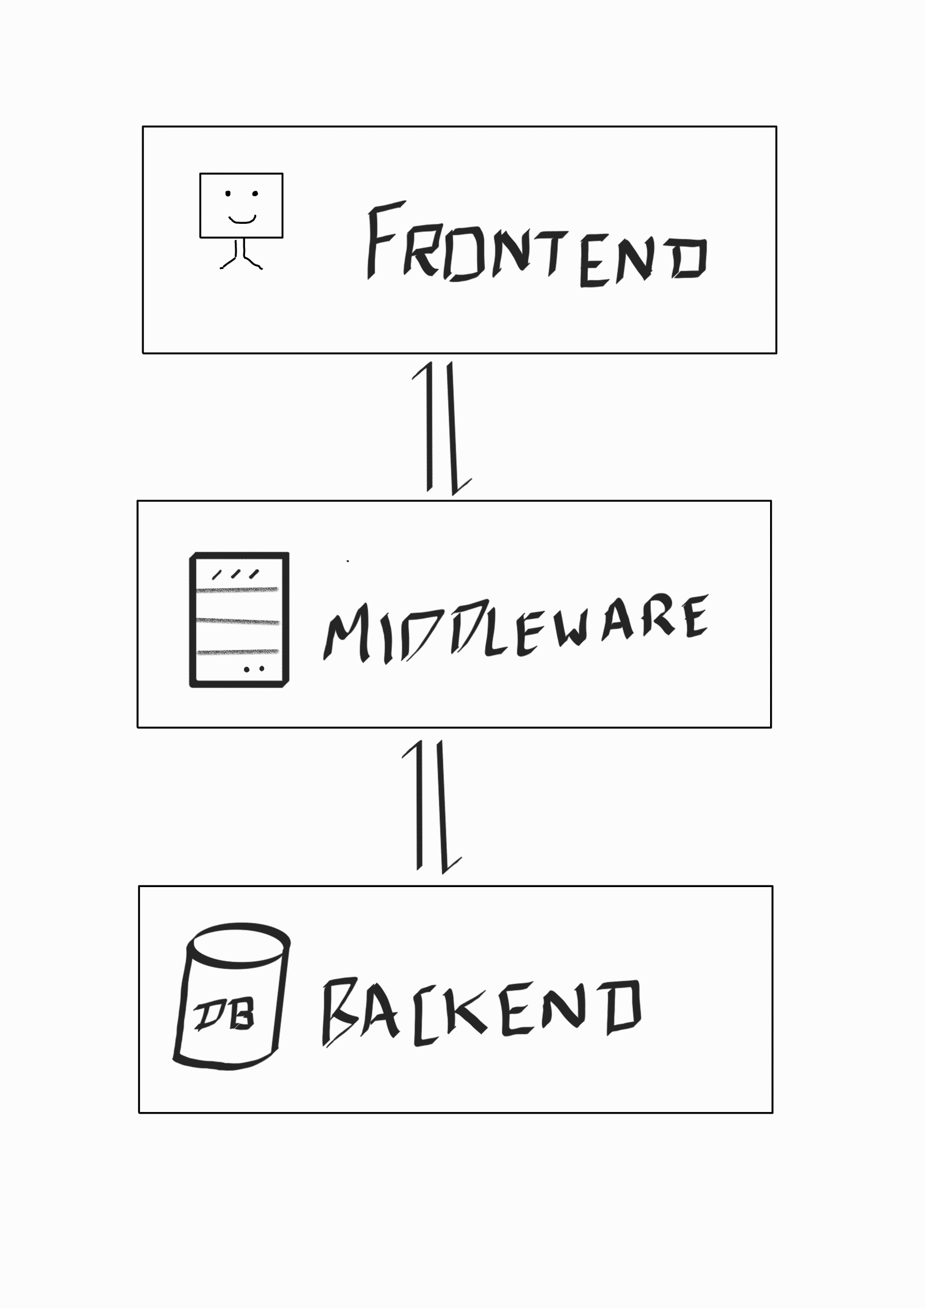
Application Architecture
User interaction
Input validation
Null safety
HashMap
Pairs
Acts like API
File handling
Exporting data

Slide 7
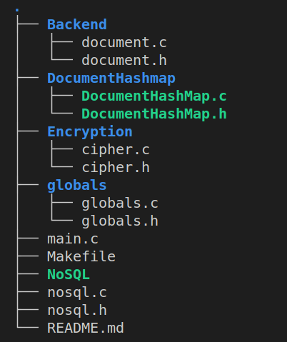
Project Structure

Slide 8
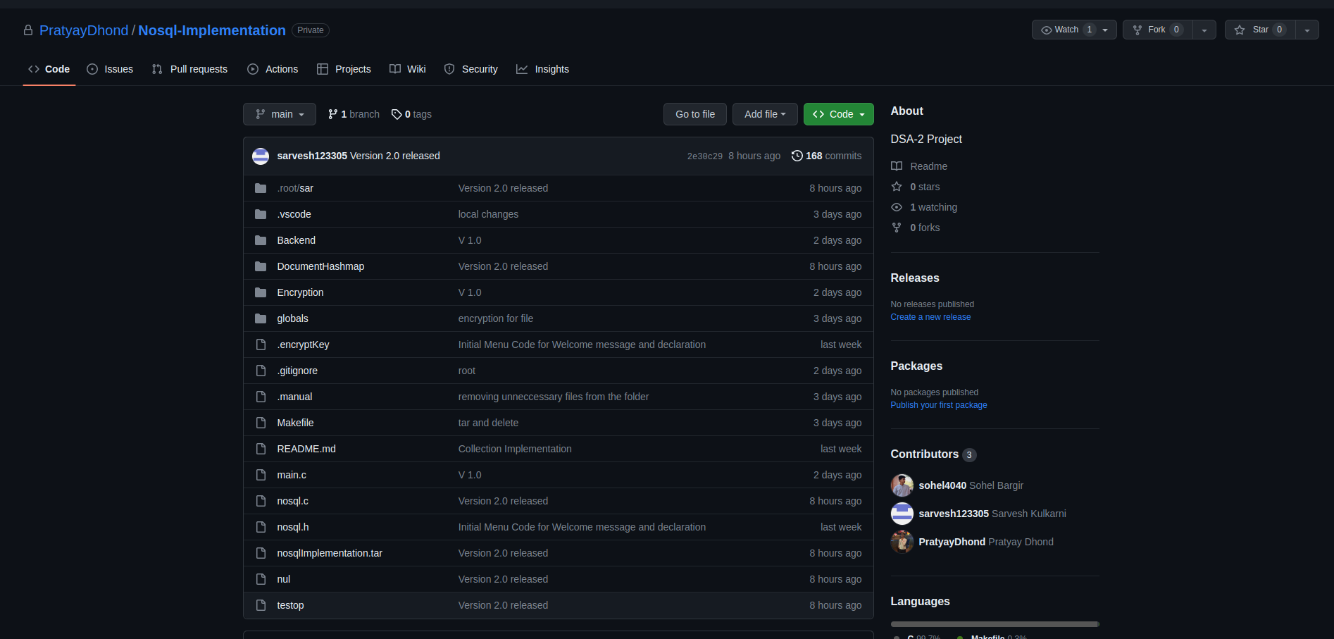
Version Controlling using GitHub

Slide 9
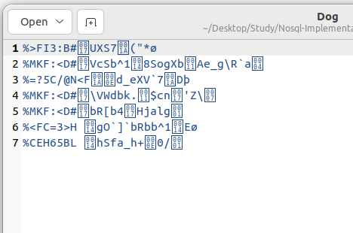
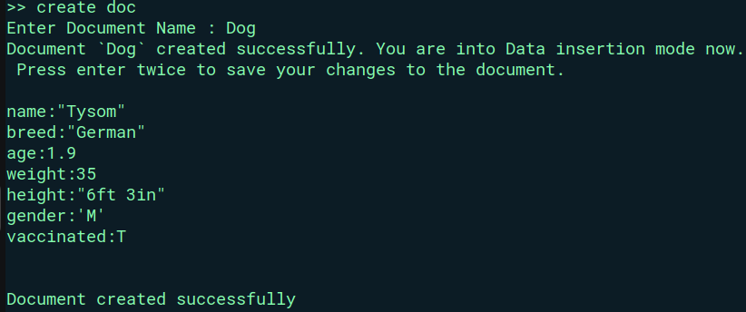
Data Storage Structure

Slide 10
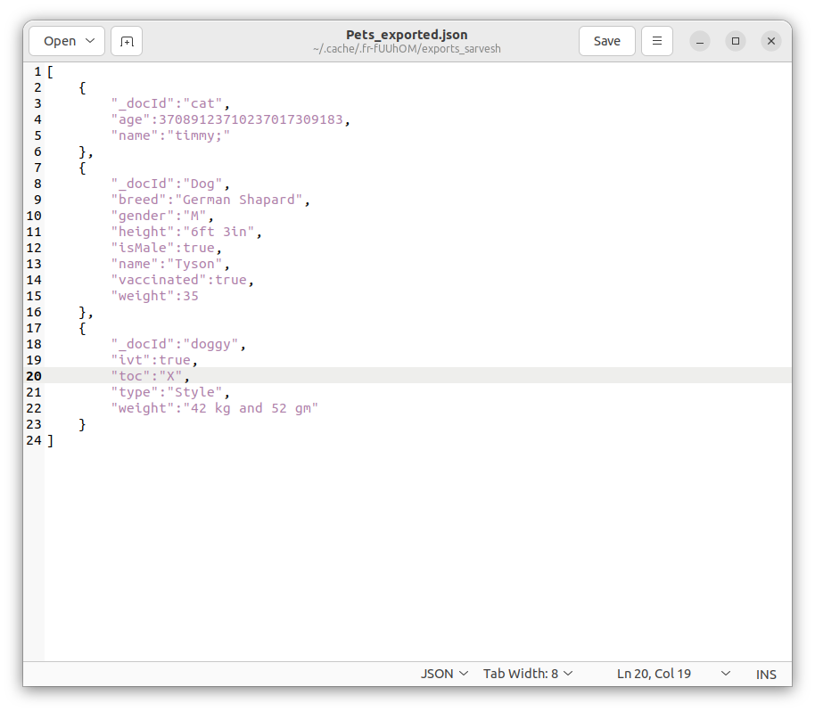
Data
Export
Format

Slide 11
Future prospects
1) Create shared documents and collections
2) Cross Platform compatibility
3) Remote server deployment
4) Better Encryption Algos
5) More-fluid Data format support
6) API for direct access to programming languages.

Slide 12
Lessons Learned
Encryption and Decryption.
JSON Serialization.
Frontend, Middleware, and Backend Architecture.
Unit Testing , Integration Testing and debugging.
Better documentation and code organization.
Choosing appropriate Data structures.

Slide 13
Project Demonstration

Slide 14
References
A Study of NoSQL Database (Research Paper)
NoSQL Data Management Systems (Research Paper)

Slide 15
Thank You!!!
Any Questions?

